Slide 1
AUTOMATIC TEXT SUMMARIZATION OF COVID-19 RESEARCH ARTICLES USING SPARSE ATTENTION BASED TRANSFORMER - BIGBIRD
Nisha Devendra Kumar
Student number: 944554

Slide 2


MOTIVATION AND BACKGROUND
Covid -19 pandemic has resulted in global health crisis.
There has been a spike in the research activities in this domain as the world needs urgent solutions to pause the pandemic.
Summarization of lengthy research documents such as COVID-19 is still a challenge in NLP domain.
Existing Transformer based summarization have limitations with respect to input sequences.
Sparse Attention Transformer- BIGBIRD is a new model that can process input sequences up to 4096 tokens.
Possibility of improvising research article summarization using BIGBIRD can be further explored.

Slide 3
RESEARCH QUESTION
Can BIGBIRD address the gaps in the existing summarization strategies of long scientific documents such as COVID-19?
Can adding extractive summarization layer before the BIGBIRD’s abstractive summarization model enhance the performance of the summarization pipeline?
Is the performance of BIGBIRD satisfactory for short, medium and long sized documents of CORD-19 dataset?

Slide 4
METHODS
Data
Data: CORD-19 Open Research Dataset
Main variable: Articles and Sections
Target variable: Abstract
Done data pre-processing to handle missing values, foreign language text, redundant text
For Research took articles up to length 5000 words (80% of total corpus)
Model Training
Created two summarization pipelines for comparison
Only BIGBIRD
BIGBIRD with extraction layers
Model Evaluation
Two models were evaluated on ROUGE score and compared to find the best model.

Slide 5
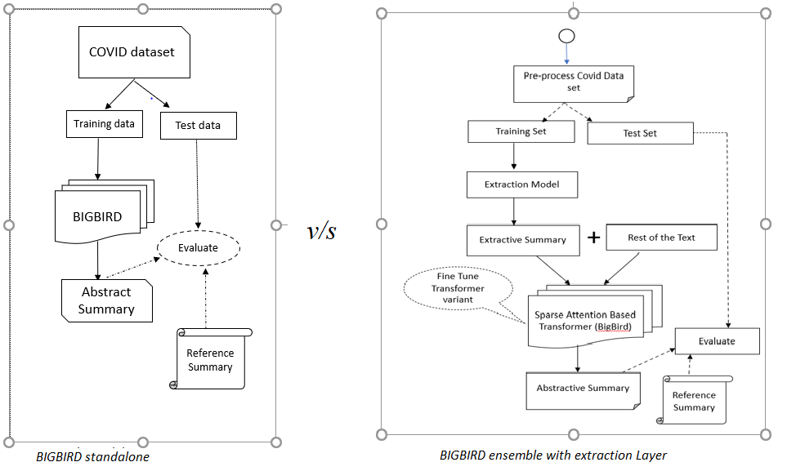
Flow Diagram of the two proposed architectures

Slide 6
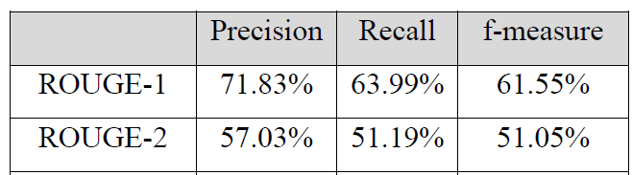
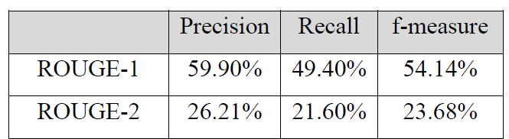
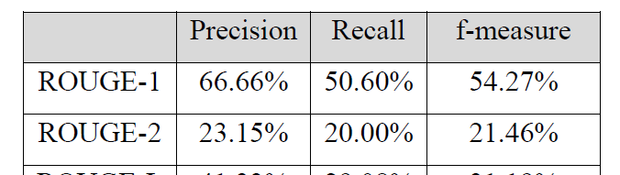
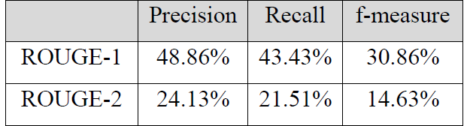
RESULTS
Below is the maximum rouge scores attained on test dataset for the two models
Summarization pipeline with BIGBIRD
Short Articles (word count<2000)
Long Articles(word count>4000)
Summarization pipeline with Extraction Layer & BIGBIRD
Short Articles (word count<2000)
Long Articles(word count>4000)
BIGBIRD standalone performs better than the BIGBIRD with extractive layer

Slide 7
CONCLUSIONS AND DISCUSSION
BIGBIRD outperforms the task of automatic summarization on CORD-19 dataset
The quality of the summary generated is good and covers the context specified in ground truth summaries in majority of the samples
The quality of summarization is impacted when article context is dominated by numerical analysis.
The extraction layer is not boosting the performance of summarization on the contrary it is reducing the performance when compared to BIGBIRD standalone summarization pipeline.
The performance of BIGBIRD ensemble with extraction layer starts improving when the article length exceeds 4500 and becomes comparable to that of BIGBIRD standalone pipeline.

Slide 8
CONTRIBUTIONS
This research has proved the BIGBIRD is an efficient model for difficult NLP tasks such as summarization especially in research community. This study has proved that BIGBIRD can perform independently and still outperform the contemporary transformers in the biomedical domain.
This also sets the stage for leveraging BIGBIRD’s capacity for other NLP tasks in the current coronavirus pandemic such as Q&A and information retrieval system.
This research is intended to help the medical research community to keep up with the rapidly growing coronavirus literature and draw insights in a short turnaround time to fight the pandemic

Slide 9
FUTURE WORK
BIGBIRD when trained to a greater number of epochs can further improve the performance
The evaluation of abstract summary requires more exploration as ROUGE scores do not always reflect the quality of generated summaries.
The BIGBIRD ensemble with extraction layer can be leveraged for documents that are excessively long. The extraction layer can reduce the document to 5000 words and this can be used as input to BIGBIRD summarization model. More experiments are needed to ascertain the performance.

